Slide 1

Final case study INT4023
Dalton Murray

Slide 2
Website To Clone

Slide 3
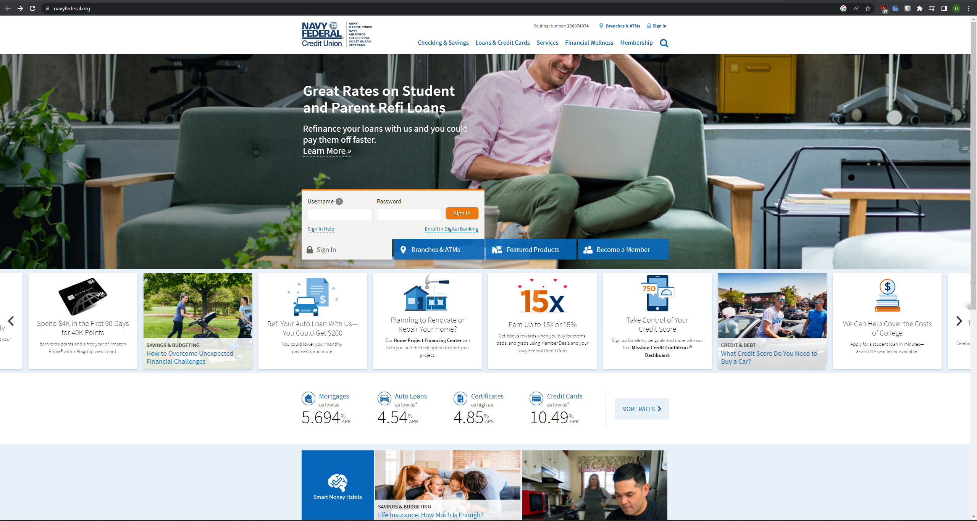
Navy Credit Federal Union - Ironic

Slide 4
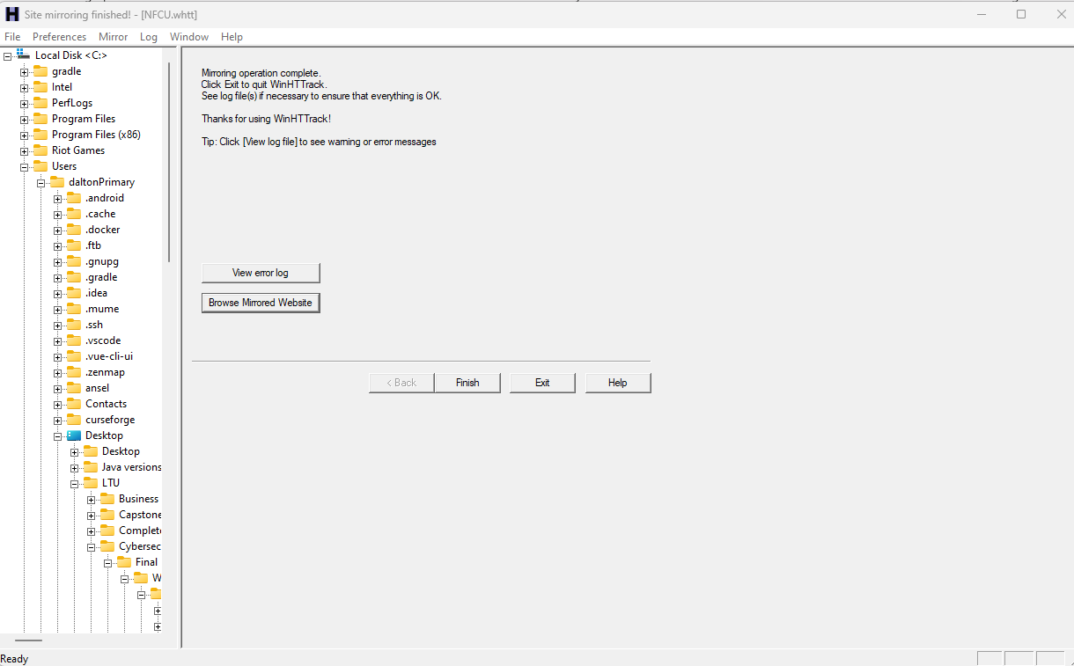
Software
HTTrack

Slide 5
Errors
HTTrack –
Unable to get some images
Manually got the images and placed in correct paths and named
File paths incorrect
Corrected file paths in website
Non-working php
Corrected php and database information

Slide 6
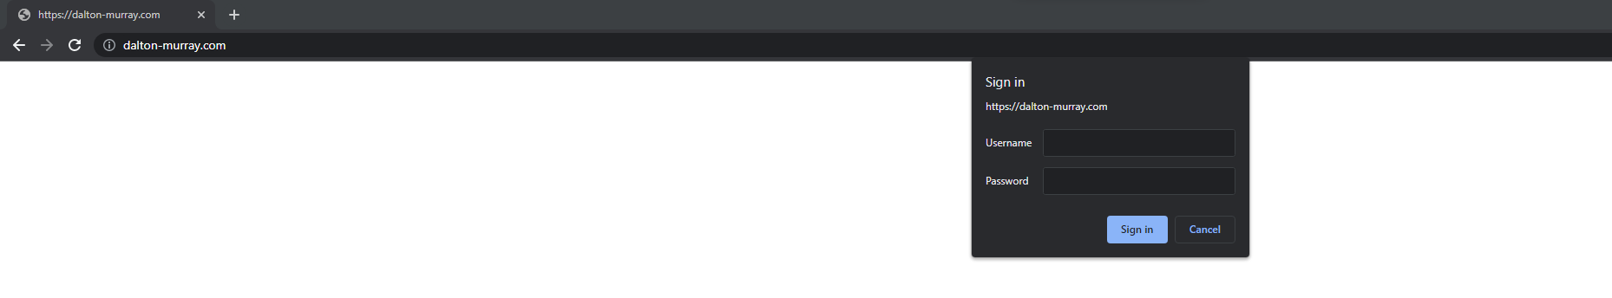
Password protected – Educational purposes only

Slide 7
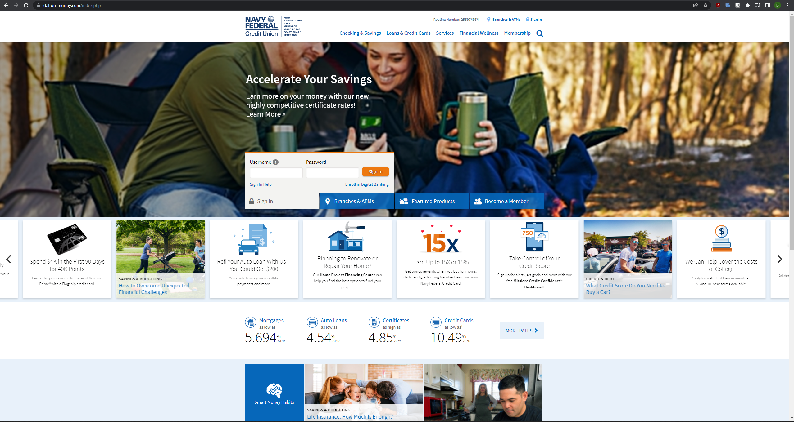
Cloned website – TLS/SSL protected

Slide 8
Database & Form

Slide 9
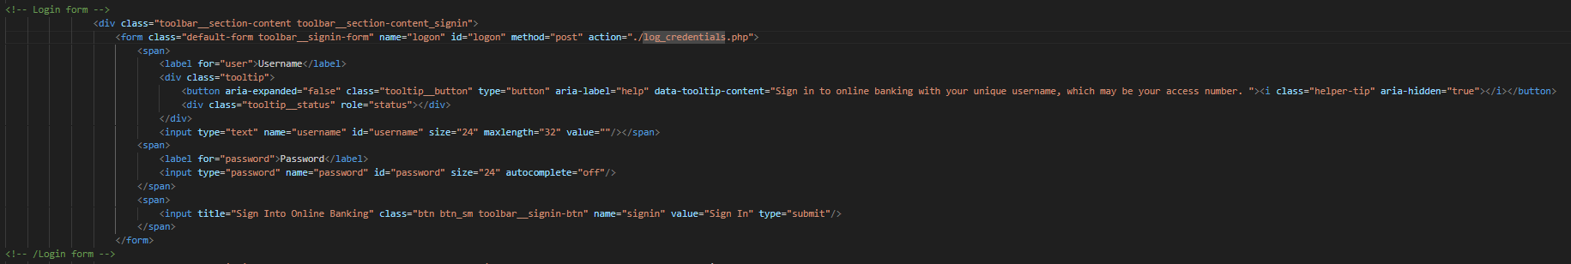
Login form

Slide 10
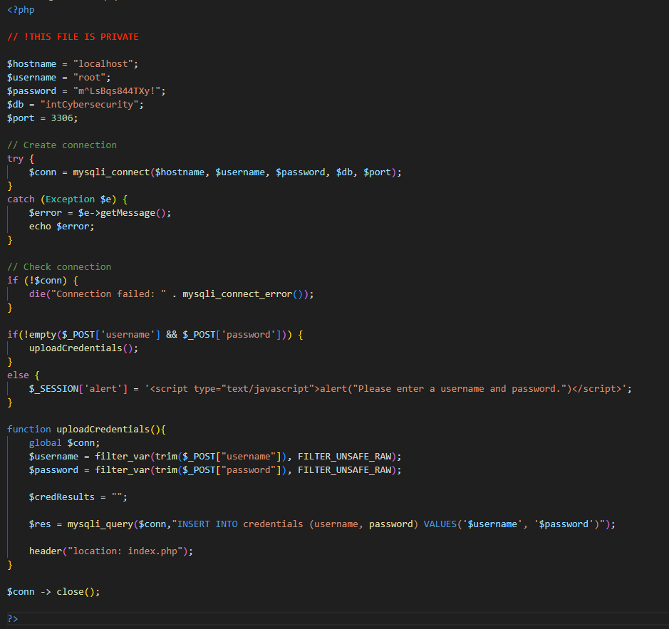
Logger
For fun I also did basic sanitization to prevent SQL injection.
As a side note, I also prevented XSS by using Cloudflare and their WAF.

Slide 11
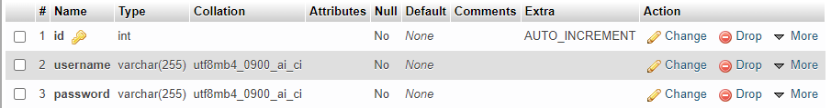
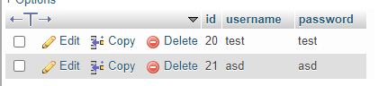
Database

Slide 12
Phishing Email

Slide 13
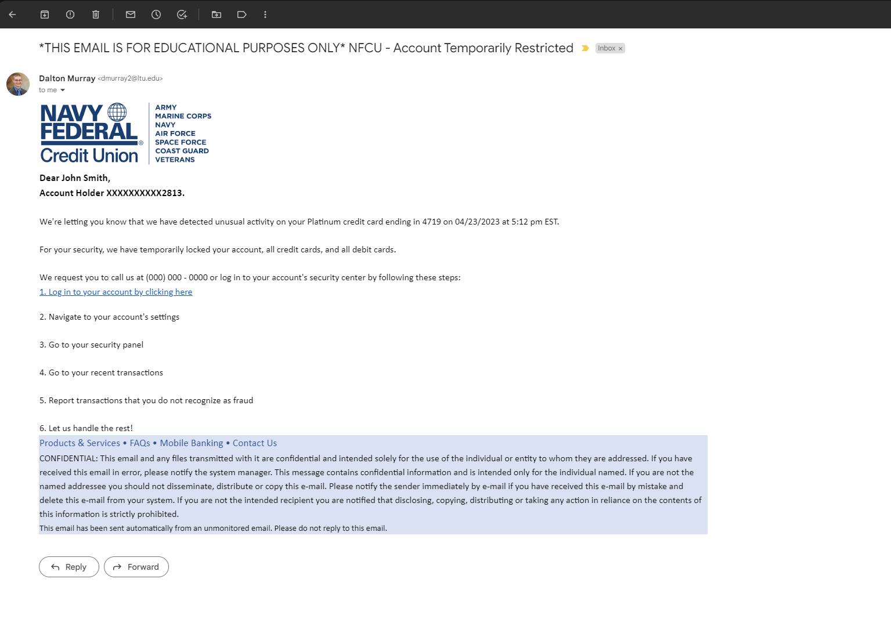
Example Email
Information about target would be obtained before hand with social engineering so that we can get their account ID and last 4 of credit card (or we could just get their username and password through social engineering)
Email would also be sent from a spoofed email.

Slide 14
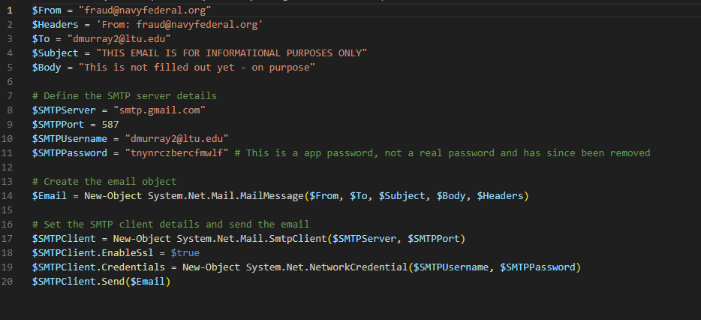
Spoofed Email
Close to working example, would have to use a different site/invisible/ascii characters as they have DMARC protection, other than that this script can send emails, given there is no protection.

